Slide 1
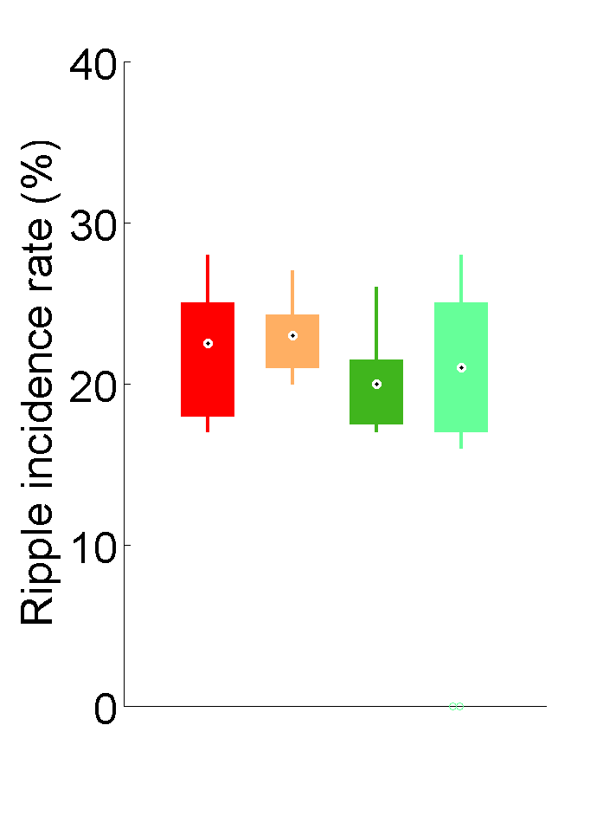
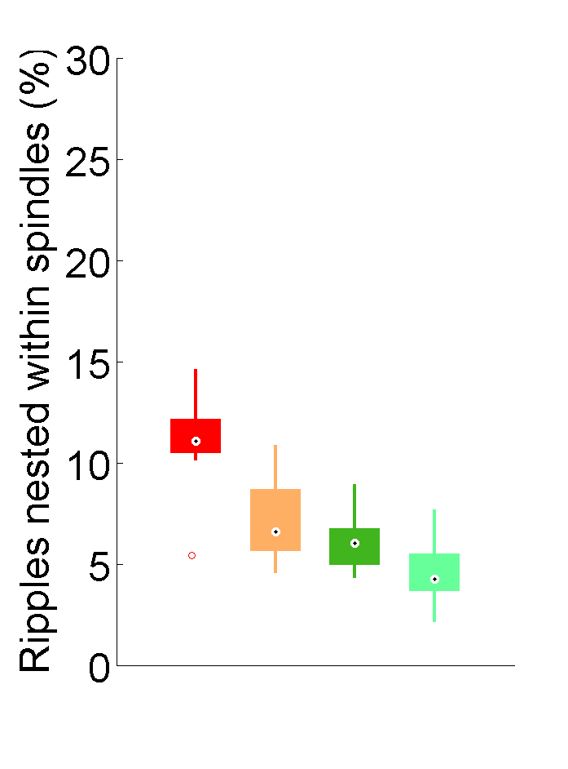
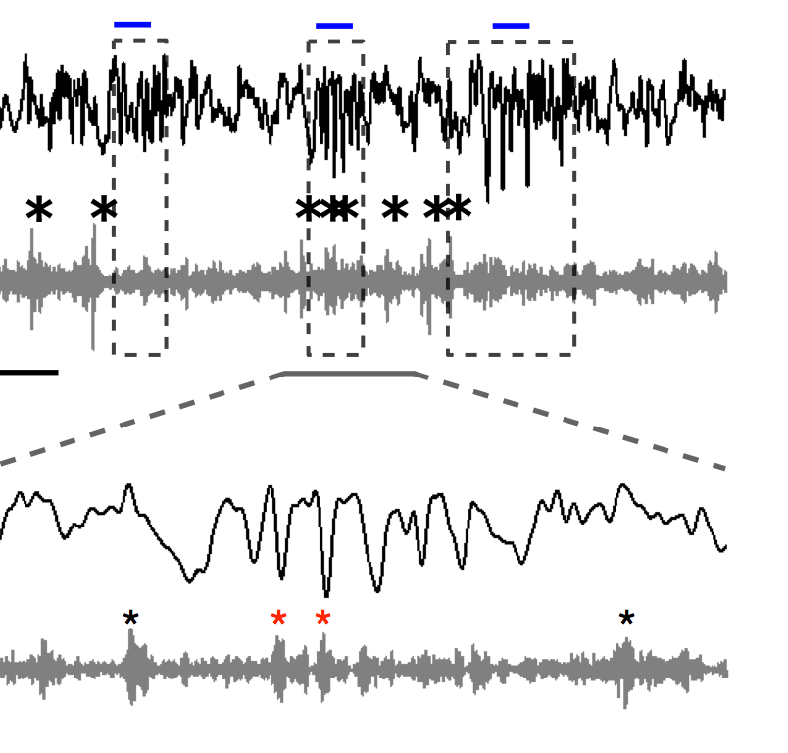
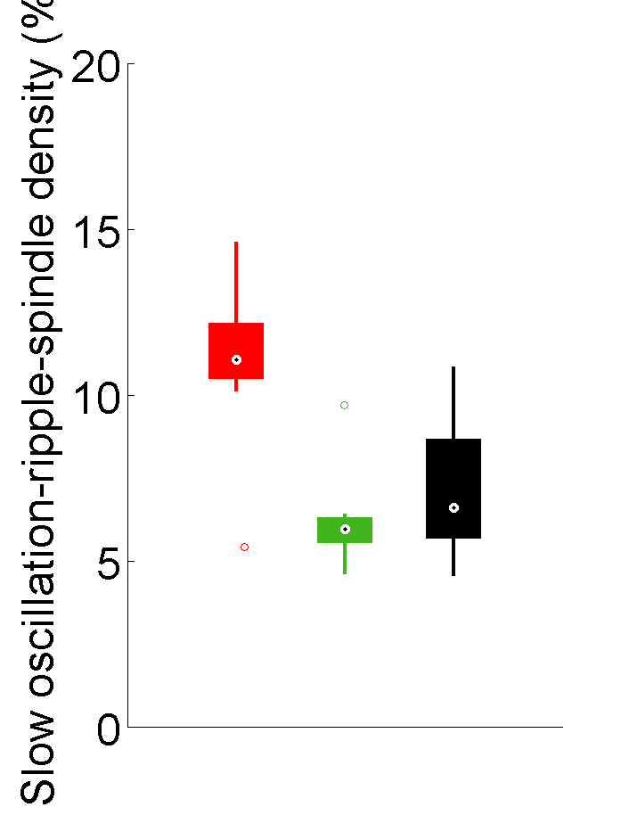
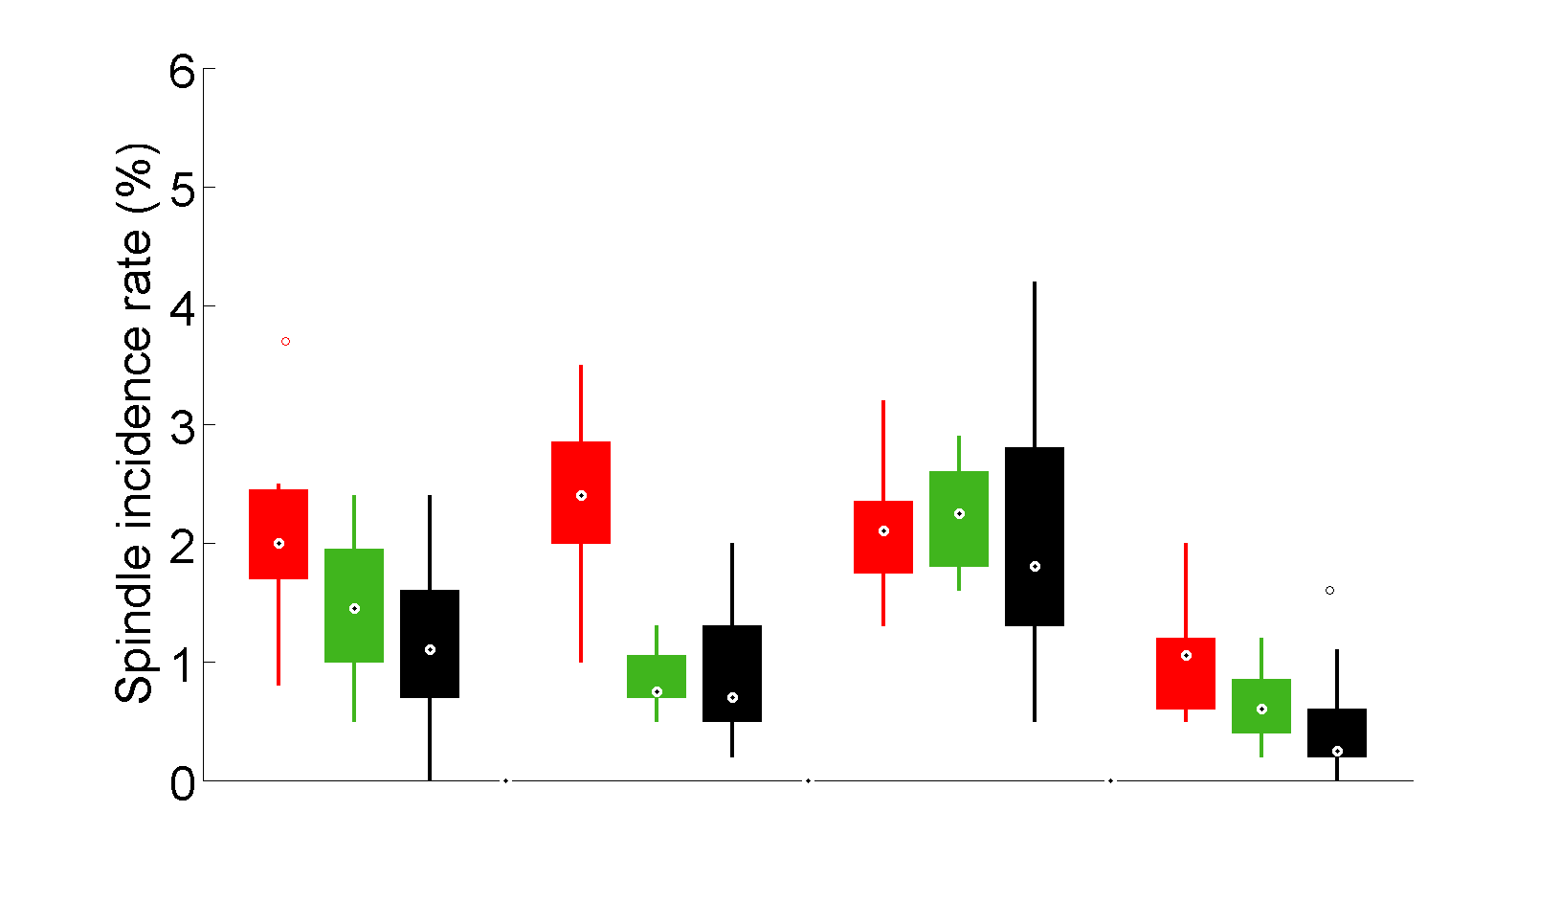
A
B
CA1
C
FRO
***
FRO EEG
***
Co-occurring Spindle-Ripple incidence rate (%)
*
Ripple incidence rate (%)
CA1 LFP
1s
(100-250 Hz)
IN
OUT
NoSTIM-IN
NoSTIM-OUT
D
FRO
E
*
**
**
***
On-line detected SO co-occurring with spindle and ripples (%)
Cross-regional spindles co-occurring with slow oscillations and ripples (%)
FRO & PAR
FRO & CA1
PAR & CA1
Triple
IN
OUT
NoSTIM

